Slide 1
Etour is an integrated information system that aims at collecting, organizing, managing, distributing and selling services of a tourist enterprise and distribute them in real time through internet.
The functions and features of etour fulfill both requirements of outgoing & incoming.
The etour system applies to :
Tourist / travel agencies
Tour operators, hotel chains, etc.
Tourist portals that handle and manage on-line & real time bookings of tourist enterprises
Entities and organizations that provide package tour services such as Municipal, Prefectural and Regional tourist enterprises.

Slide 2
The etour on-line system collects, organizes, manages, promotes & distributes tourist services such as:
Accommodations
Airline seats (charter & scheduled flights)
Excursions
Car Rentals (rent-a-car)
Boat Rentals
Sealines
Tourist packages (scheduled packages & custom made packages) and offers
Ticketing (buses, ferries, trains, etc.)
Transportation to and from the airport, port, etc
Bus leasing and management of seats
Cruises

Slide 3
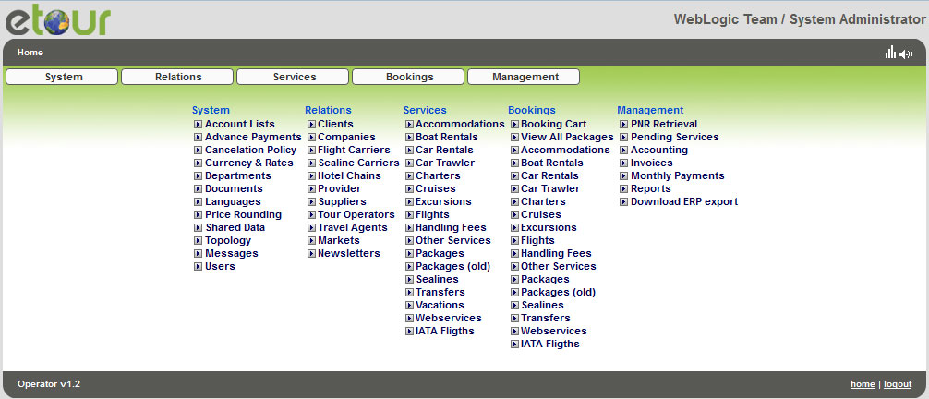

Slide 4
The etour system provides availability and costing information for all these services
The system's users are able to make reservations for the services provided be the system
As long as there is availability of a service, the user receives a direct confirmation of the booking
The toilsome procedures of telephone contacts, messaging and faxing are avoided

Slide 5
Three ways of setting up the prices
In the management of the Accommodation service type there are three available ways to set up both the net and the sales prices in four available price categories (allotment, commit, freesale, on request) to the system:
The analytic way, where the time periods are separated, the prices can be per room, per person or per pax type for all the combinations of four person types (adults, teenagers, children, infants)
The brief general way, where there is a common table with all the time periods and all the room types, the prices can be set up per room or per person type, all the information is presented in a united table
The daily plan mode way, where the prices are set up per day for each room type, in a fast and easy way day by drag and drop on the plan.
The user decided and uses the way he prefers and find easiest and most convenient for him.

Slide 6
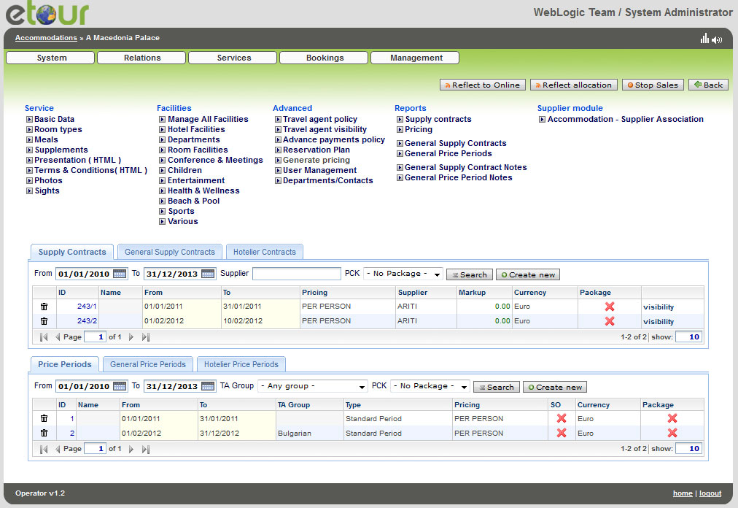

Slide 7
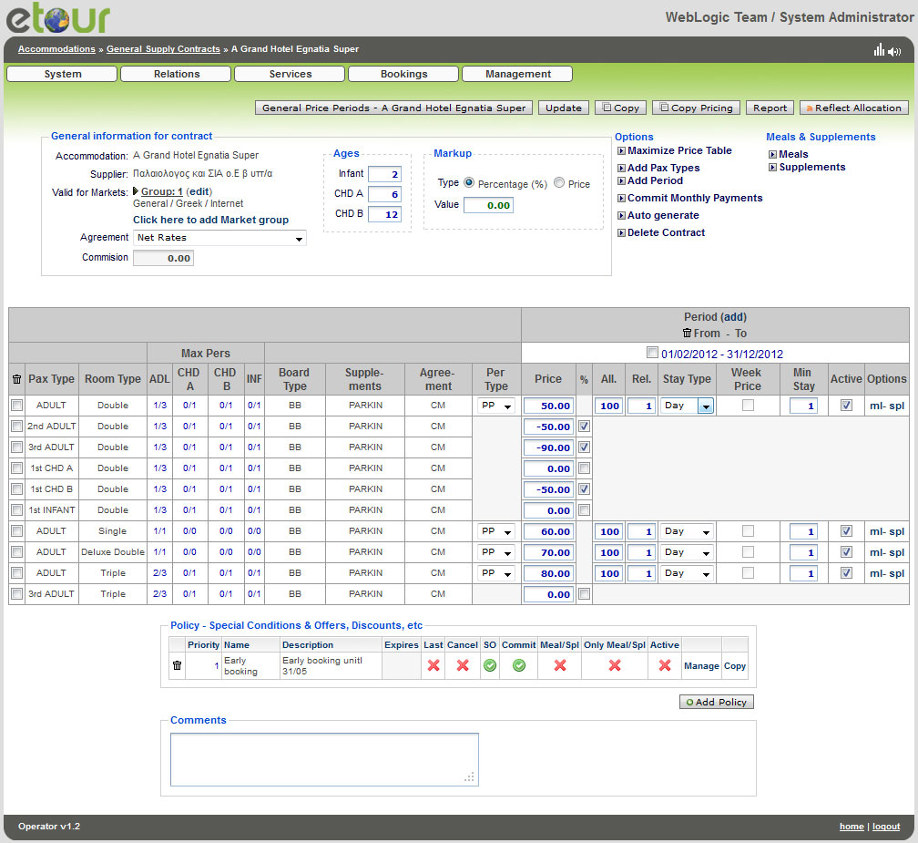
At the brief general way all the information is presented in a united table, included all the available periods, all the room types in different price categories.
The prices can be set up per room or per person type for the four available person types (adults, teenagers, children, infants).

Slide 8
3rd party packages
Easy and fast creation and management of the 3rd package service just in few steps
Combination of different services
Ability of creating new services or using general services
Multiple destinations and multiple departure places
Multiple departure dates or days
Default and extra services
Schedule of each service
Possibility of extending the days of stay with extra days fuction

Slide 9
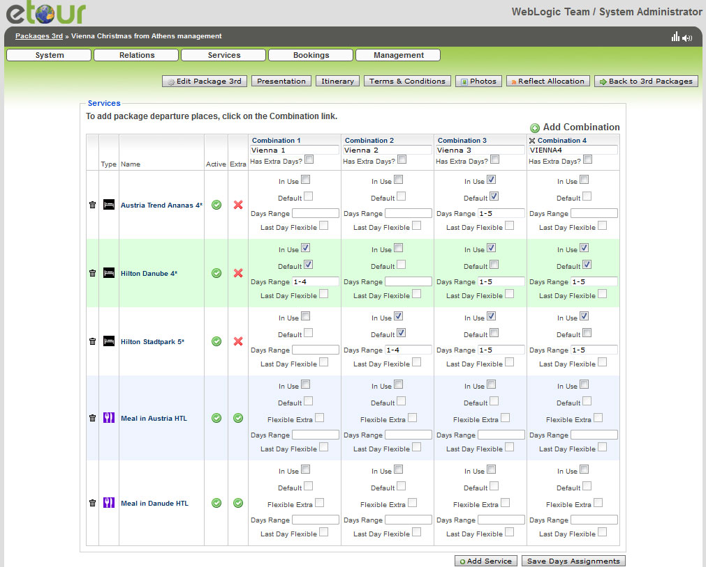

Slide 10
Car Rental services
Easy and fast way of setting up the prices through daily plan mode
Drag and drop mode
Multiple car groups for each company
Multiple charge types
Extra services
United presentation of Car Groups pricing and Extra service pricing in a common table

Slide 11
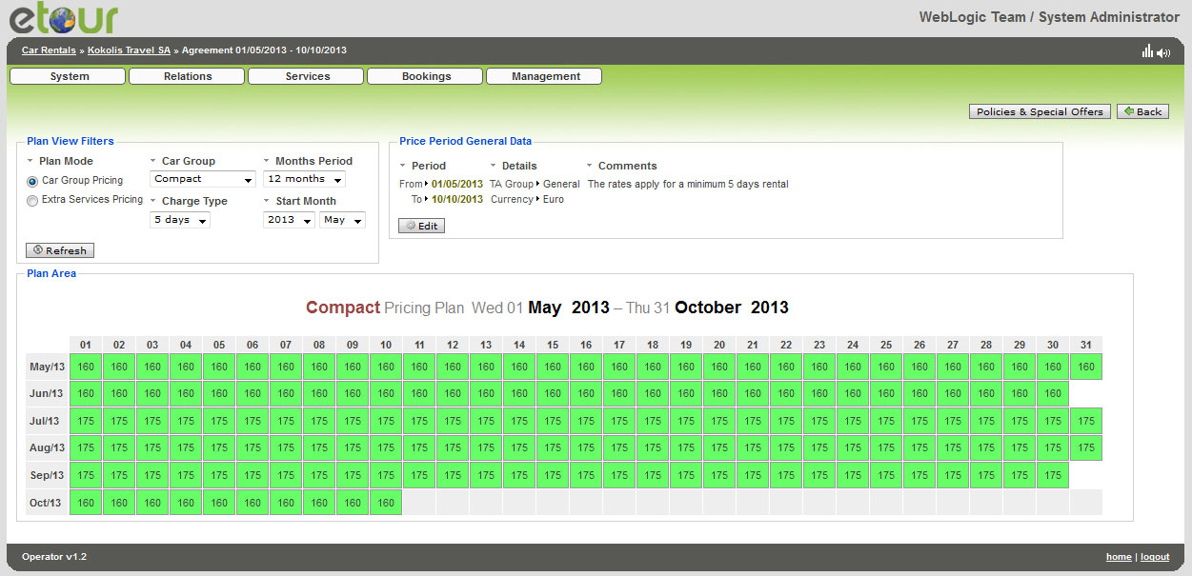

Slide 12
Reservation Plan of rooms in a Hotel
The accommodation module of etour system provides room plan for the graphical visualization of rooms in a hotel.
All the processes of a booking can be made quickly and simply on the plan, such as:
New reservation
Manage a reservation
Check in and check out
Manage and split the rooms
Accounting details for a reservation
Quick accounting and quick invoicing

Slide 13
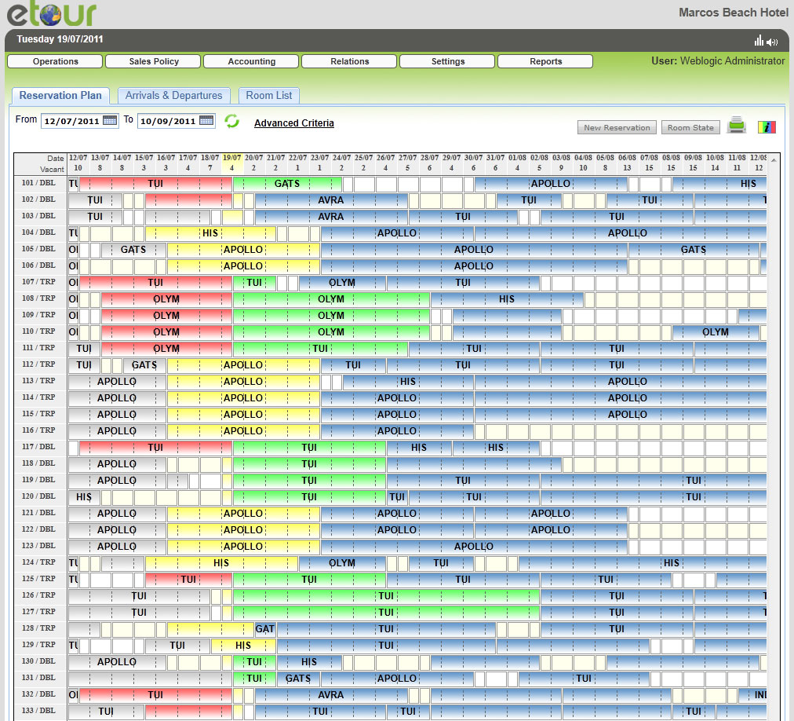

Slide 14
Daily 3-mode display of Room List
On the form below the room list is represented, including the status of the rooms as well.
The Room List display has 3 modes:
Reservation
Housekeeping
Accounting per room

Slide 15
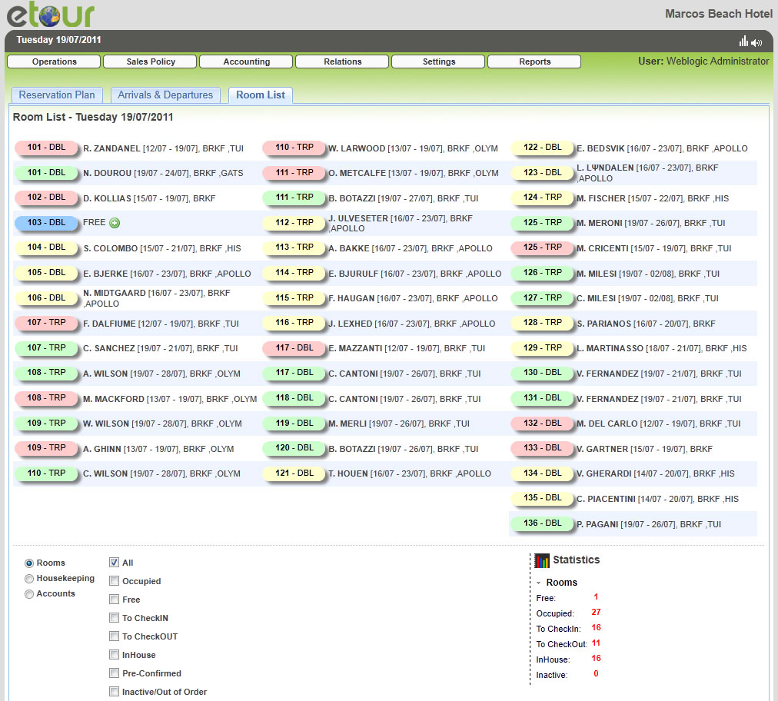

Slide 16
Management of vehicles and services
In Excursion and Transfer module the user can manage the reservations and order all the passengers in vehicles. The passengers can move from and to other pickups. Moreover, the timetable, the vehicle and the driver can be set up in the form below.
Simple and detailed reports can also be printed from the system to describe the route of each vehicle.
In case there are extra services in an excursion the passengers can also be sorted for each service.

Slide 17
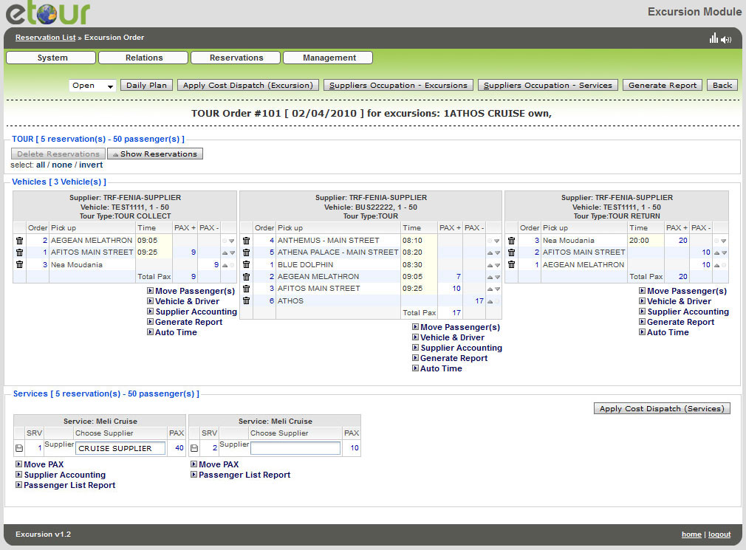

Slide 18
Making a Reservation for a service type Excursion
A Tour Operator or a representative or the single user of the system can easily and fast make and complete a reservation for an excursion.
There is the ability of creating blocks of tickets for each representative and set up commissions for each of them.
The process of liquidation is also simple as long as the commissions’ rules are set up. There can be different commissions for the Tour Operator, each Representative and the Chief Representative.

Slide 19
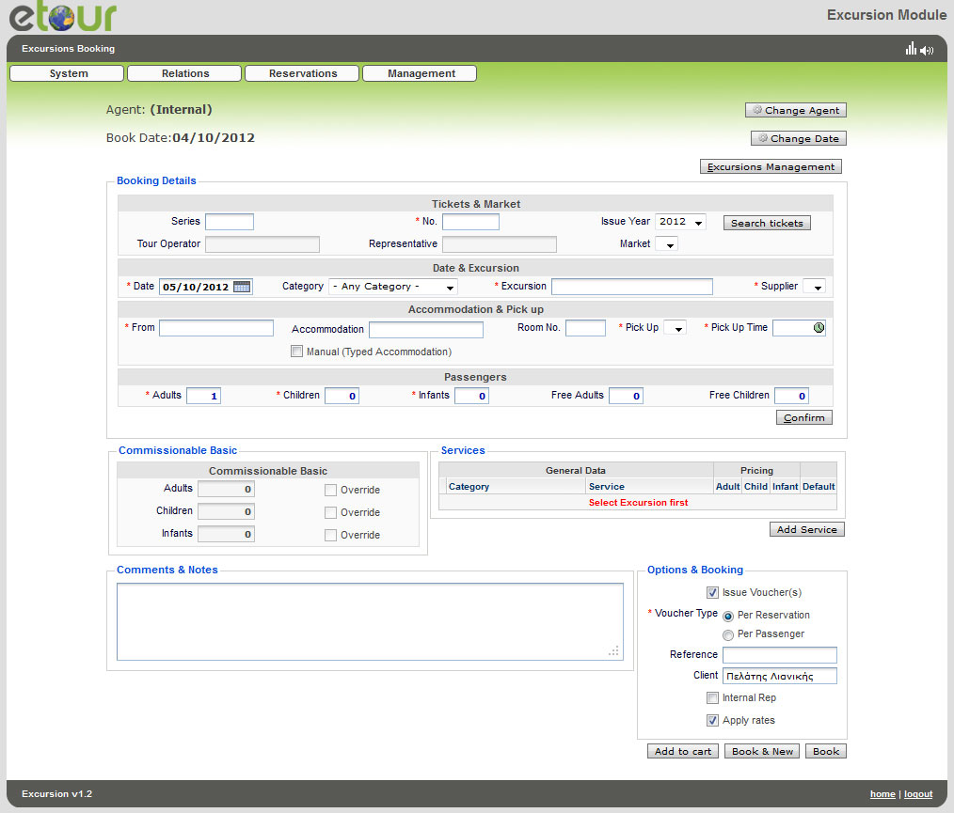

Slide 20
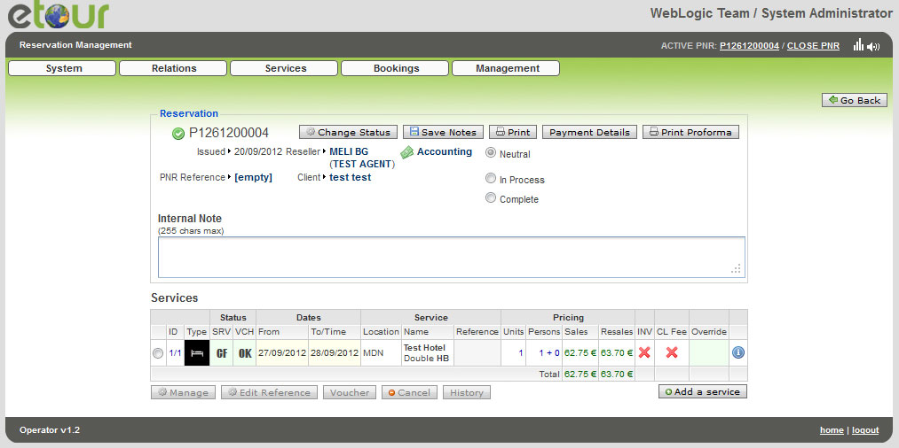
Managing a reservation in Etour system

Slide 21
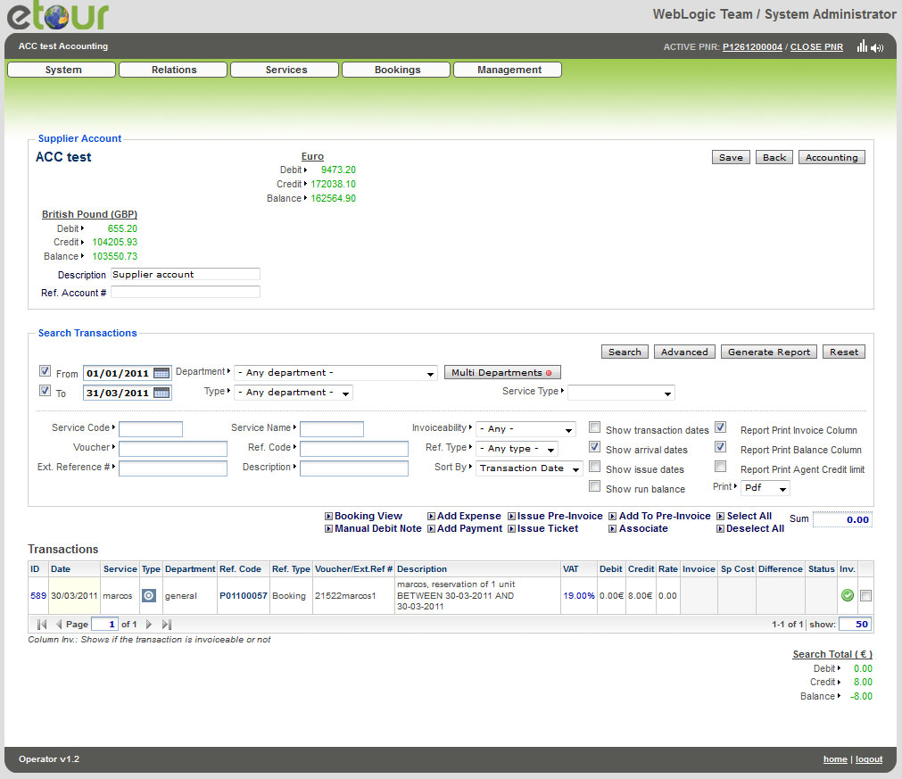
Accounting display of a Supplier

Slide 22
There is plenty of Reports in Etour system
Through the etour system all the travel documents, vouchers, tickets, etc. can be used
Moreover, there is a capability of exporting many reports that can provide a total overview of the reservations, the remaining assets and the accounting information
The etour system provides to the system's users and administrators the ability to exchange messages
The etour system has also the possibility to link (interface) with private booking systems (hotels', ferries', airplanes', etc.) as well as with accounting systems and business management packages & ERP (LogicDis, Atlantis Altec, etc.)

Slide 23
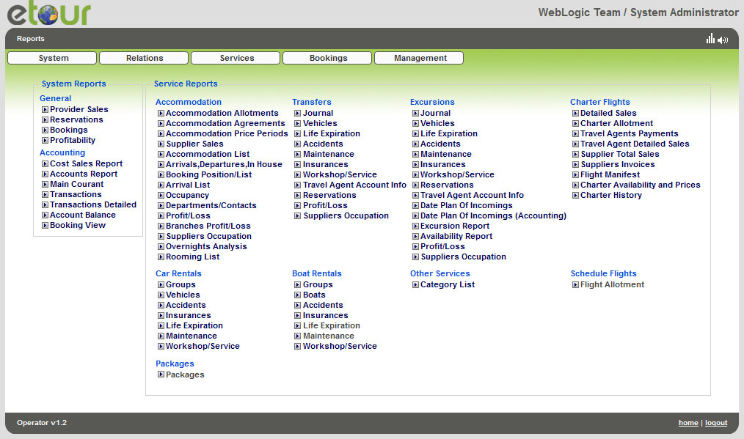

Slide 24
Three are the levels that the etour system
can offer its services:
As a selling system for the owner of the system (provider) to sell the travel services to the customers - final users of the internet (B2C).
Among many tourist enterprises, as a Business to Business (B2B) activity, (multiple service suppliers, travel agents and providers).
As an internal reservation system, in order to organize and manage the company's tourist services (intranet).
Some portals that are using the etour system are presented following:

Slide 25
